Slide 1


MARKETING
PERFORMANCE
ANALYSIS

Slide 2




WHO WE ARE ?
WHO WE ARE ?
MALAK WAHIED
MARIAM AHMED
RAHMA MAHMOUD
HAGER MUSTAFA

Slide 3
INTRODUCTION:
•This project aims to clean, analyIse, and interpret performance marketing data to gain a deeper understanding of key trends and patterns
•The final dashboard will serve as a comprehensive tool to communicate these findings effectively, highlighting correlations, anomalies, and emerging trends.
•Performance Marketing is a new and emerging field within the marketing industry and is predicted to be the biggest type of marketing in the future. Data and projects based on this concept are still quite limited despite the increasing demand for it by companies.
.

Slide 4
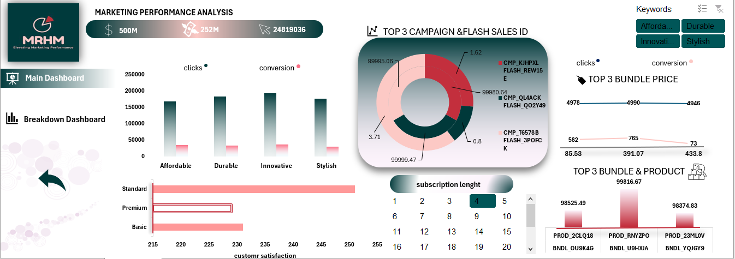
Project Wireframe and Design
The picture on the right shows one of the Dashboards we created, this one is the main dashboard in our excel file.
All dashboards contain multiple graphs of different types that allow for easier understanding and clear representation of trends.
There are slicers which allow the user to have more specific and specialized insights.
Buttons allow for easy navigation, whether that be in moving to a different page in the dashboard or clearing any selections made.

Slide 5
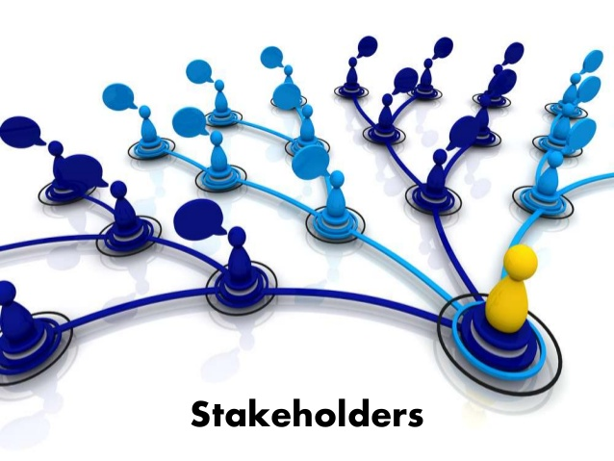
Who is our target audience?
Our target audience are stakeholders and other senior employees in managerial positions within our company.
The dashboards created are easy to understand and focus on the overall picture of our data rather than the day-to-day transactions and records.
This means that the dashboards and insights derived from it focus on trends and patterns that affect the business decisions of the company.

Slide 6
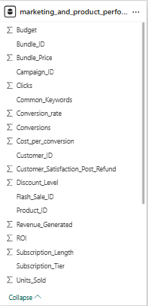
Structure of our Data
This is a non relational database that originally contained 17 columns and 10000 rows.
Through cleaning and preprocessing we have added multiple columns and checked the data for any errors or inconsistencies.
Key entities include Order ID, Customer ID and Product ID.
The data is stored on both SQL database and Excel files.

Slide 7




OUR TOOLS :
EXCEL
MY SQL
python
Power bi

Slide 8
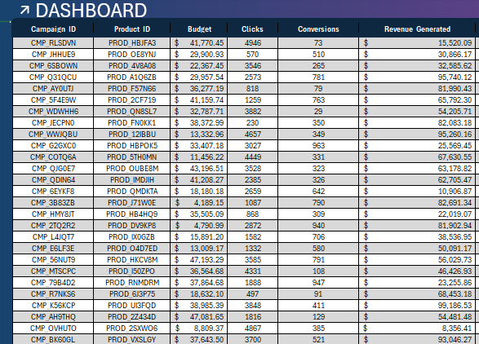
EXCEL :
Cleaning :
The data was exceptionally clean, meaning it was free from common issues such as missing values, inconsistencies, or formatting errors that often require preprocessing. Additionally, there were no duplicate entries, which ensured the integrity and reliability of the dataset. When I utilized the pivot query to explore and summarize the data, I found that it was already well-structured and organized

Slide 9
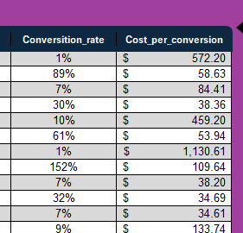
EXCEL :
Preprocessing :
enhanced the dataset by adding two new columns to provide deeper insights:
1- Conversion Rate:
The formula used is =[@Conversions] /[@Clicks]
This allowed me to express the conversion efficiency as a percentage
2-Cost per Conversion:
The formula for this metric is =[@Budget] / [@Conversions]
] This metric helped in assessing the financial performance of the conversion process
.Additionally, I refined the formatting of the dataset’s columns to improve clarity. For example, I formatted the Revenue column to include a dollar sign (e.g., $1,234.56) for clear financial representation. The Conversion Rate column was formatted to display as a percentage (e.g., 25.00%) to align with standard reporting practices.

Slide 10
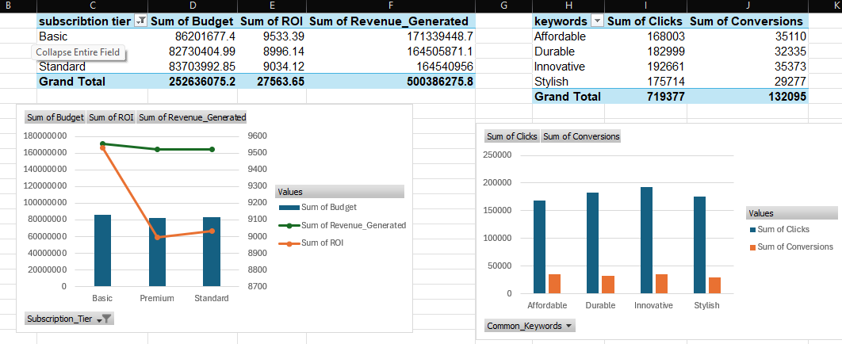
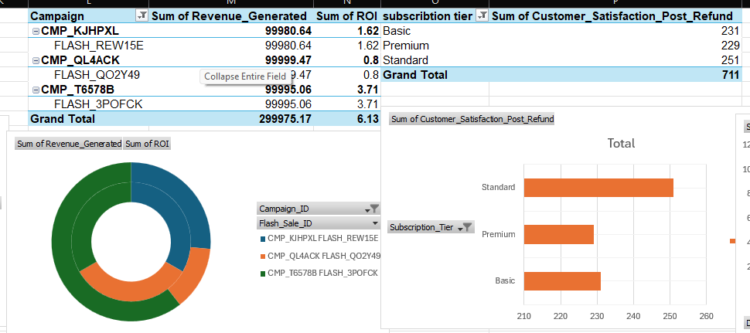
EXCEL :
Revenue, Budget, ROI by Subscription tier: Pivot table showing Profit, Cost, and ROI per subscription, visualized with a Combo Chart (columns for Profit/Cost, line for ROI).
Clicks and Conversions by common Keywords: Pivot table for Clicks and Conversions of the most common keywords, shown in a Column Chart.
Analysis :
Top 3 Campaigns by Profit and ROI: Pivot table for the top 3 campaigns by Profit and ROI, visualized with a Donut Chart.
Satisfaction Refund by Subscription: Pivot table for Satisfaction Refund per subscription, displayed in a Horizontal Bar Chart.

Slide 11
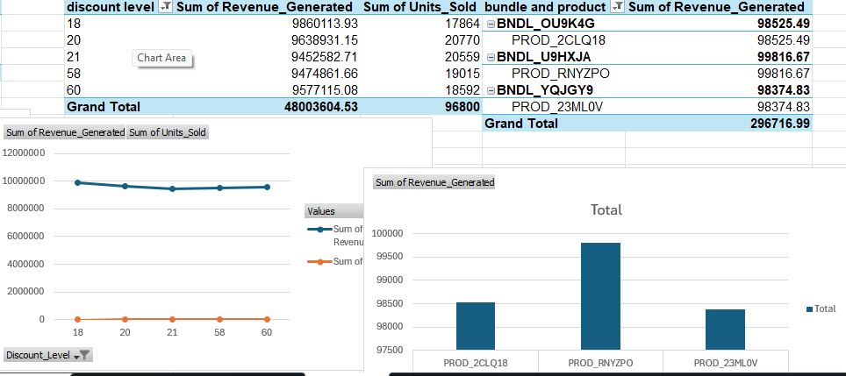
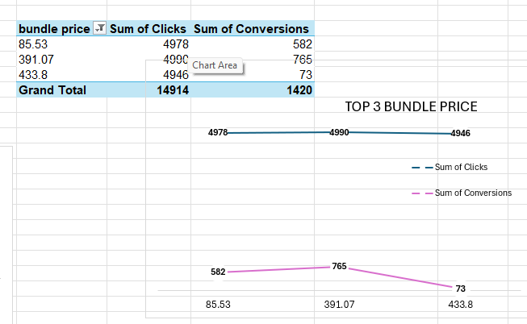
EXCEL :
Top 5 Discounts by Profit and units : Pivot table for the top 5 discounts by Profit and Sales, shown in a Line
Top 3 Bundles/Products by Profit: Pivot table for the top 3 bundles/products by Profit, visualized in a Column Chart.
Analysis :
Top 3 Bundle Prices by Clicks and Conversions: Pivot table for the top 3 bundle prices by Clicks and Conversions, displayed in a Line chart

Slide 12
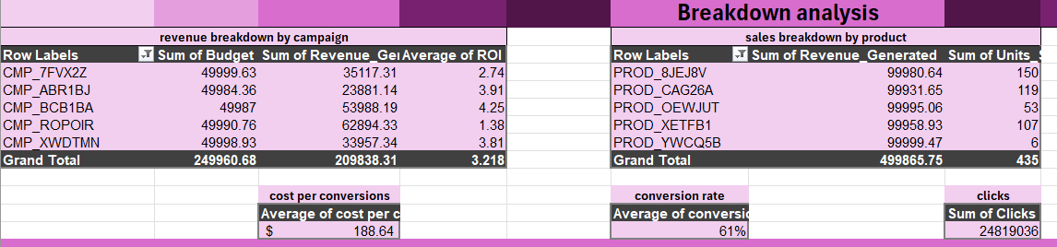
EXCEL :
Analysis :
You can see the pivot tables of breakdown analysis for revenue breakdown by campaign / sales breakdown by product / cost per conversion / conversion rate/ clicks / ROI

Slide 13
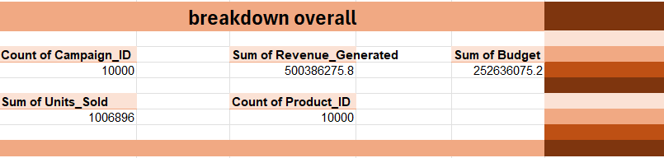
EXCEL :
Analysis :
And also you can see the breakdown overall :
Count of campaigns/ revenues/ budgets/ units / products

Slide 14
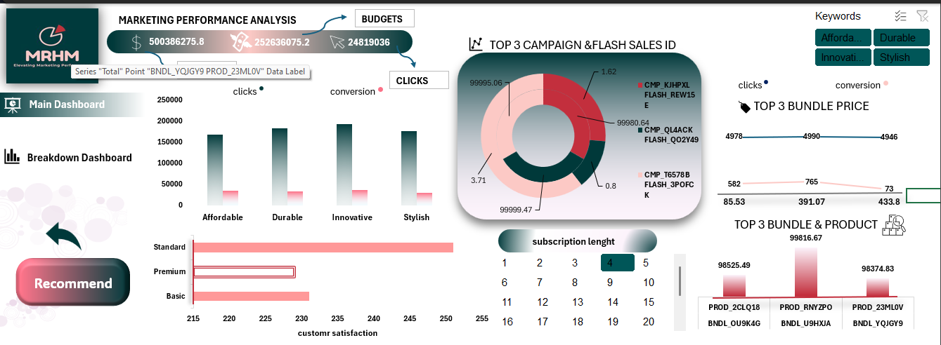
EXCEL :
Visualization :

Slide 15
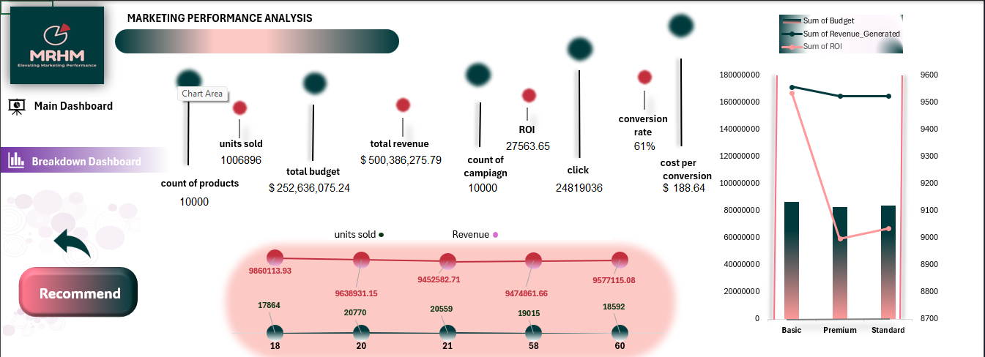
EXCEL :
Visualization :

Slide 16
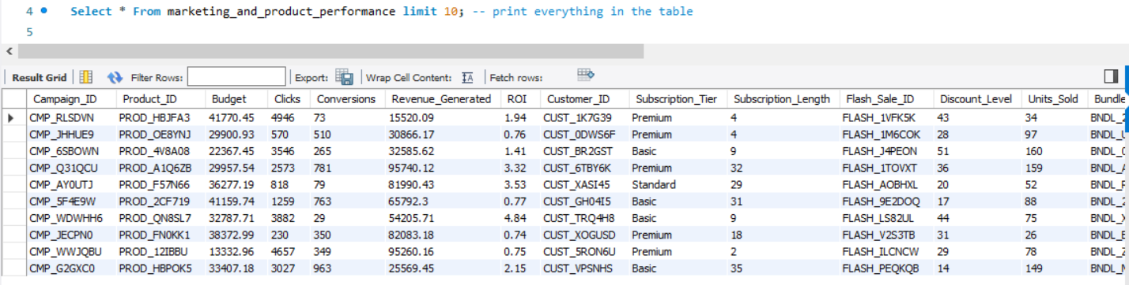
MY SQL:
DATA RETRIEVAL:
What I did:
Loaded pre-cleaned data from Excel into SQL
Verified all columns were imported correctly
Confirmed data types matched the cleaned Excel format
Verified column data types matched expectations
Checked for obvious anomalies
Key Benefits:
Ensured analysis starts with accurate, consistent data
Reduced time spent cleaning data within SQL
Quick understanding of available data fields
Early detection of potential data quality issues

Slide 17
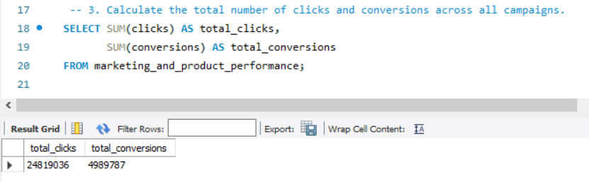
MY SQL:
BASIC METRICS :
What I did:
Calculated foundational KPIs (total campaigns, revenue, budget)
Computed averages (conversion rate, ROI, profit margin)
Key Benefits:
Established performance benchmarks
Identified whether numbers matched business expectations

Slide 18
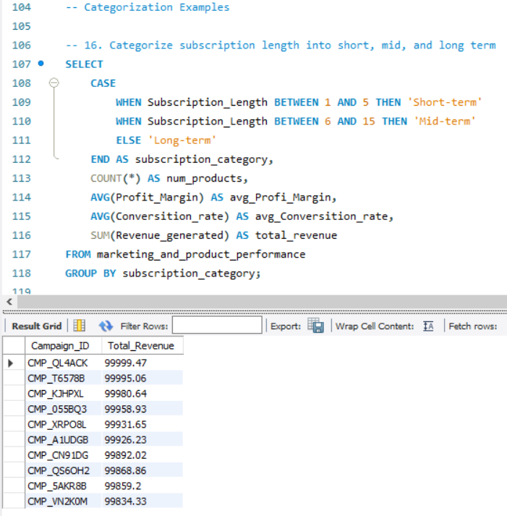
MY SQL:
SEGMENT ANALYSIS :
What I did:
Grouped data by meaningful categories (discount tiers, subscription types)
Compared performance across segments
Key Benefits:
Revealed which customer/product segments perform best
Highlighted opportunities for targeted improvements

Slide 19
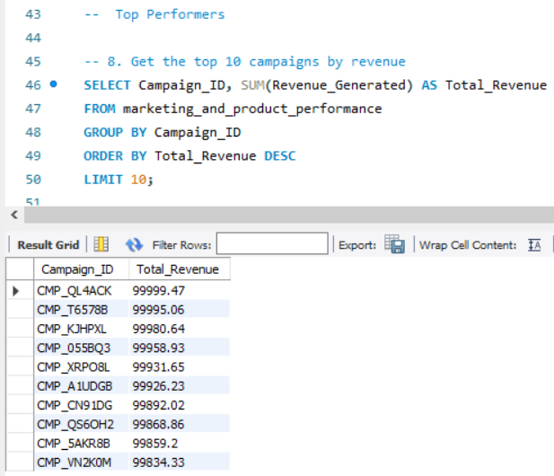
MY SQL:
PERFORMANCE RANKING :
What I did:
Identified top/bottom 10 campaigns by key metrics
Flagged high-performing products and customers
Key Benefits:
Clear visibility into what's working vs. what's not
Data-driven resource allocation decisions

Slide 20
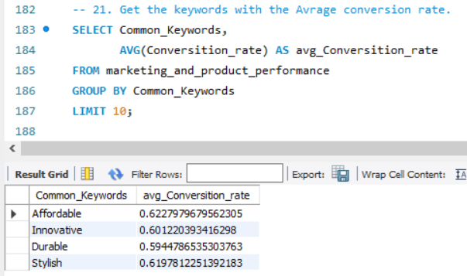
MY SQL:
PROBLEM DETECTION :
What I did:
Found campaigns with high clicks but low conversions
Analyzed discount impact on profit margins
Key Benefits:
Pinpointed optimization opportunities
Prevented wasteful spending on ineffective strategies

Slide 21
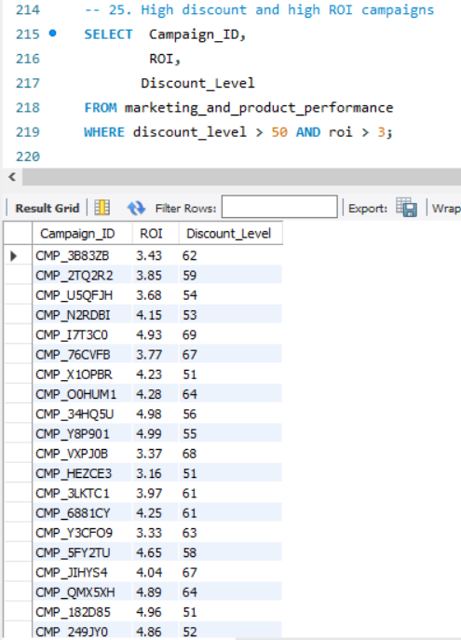
MY SQL:
ACTIONABLE INSIGHTS :
What I did:
Developed specific recommendations based on findings
Created clear next steps for marketing team
Key Benefits:
Transformed raw data into executable strategies
Aligned analysis with business objectives

Slide 22
MY SQL:
Insights :
1.Get the top 10 campaigns by revenue.
2. Get campaigns with the highest ROI.
3. Get campaigns with the highest conversion rate.
4. Calculate the average budget per campaign.
5. Get the top 10 best-selling products by units sold.
6. Get the top 10 products by revenue.
7. Calculate the average customer satisfaction per product.
8. Get the products with the highest customer satisfaction.
9. Get the top 10 customers by total spending.
10. Get customers with the highest conversion rate.
11. Calculate the number of customers in each subscription tier.

Slide 23
MY SQL:
insights:
12. Calculate the average subscription length per customer
. 13. Get the top 10 flash sales by revenue.
14. Analyze the impact of discount level on units sold
15. Get the top 10 bundles by units sold.
16. Get the top 10 bundles by revenue.
17. Calculate the average bundle price per product.
18. Get the most common keywords.
19. Get keywords with the highest conversion rate.
20. Calculate total revenue.
21. Calculate total clicks and conversions.
22. Calculate the average customer satisfaction per subscription tier along with total revenue.
23. Calculate the difference in customer satisfaction between each campaign and the previous campaign for each customer.02:04 PM

Slide 24
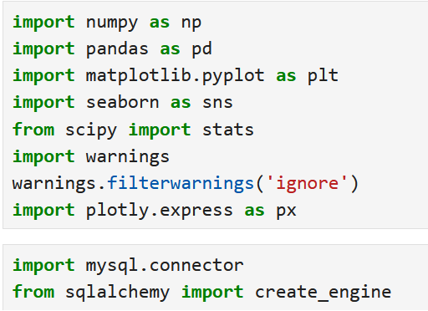
Python:
LIBRARIES USED :
pandas (pd) - Core data manipulation (DataFrames, SQL queries, calculations)
numpy (np) - Numerical
sqlalchemy - Database
mysql-connector - MySQL
matplotlib.pyplot (plt) - Basic visualization.
seaborn (sns) - Statistical
plotly.express (px) - Interactive visualization.
scipy - Scientific
warnings - Alert management

Slide 25
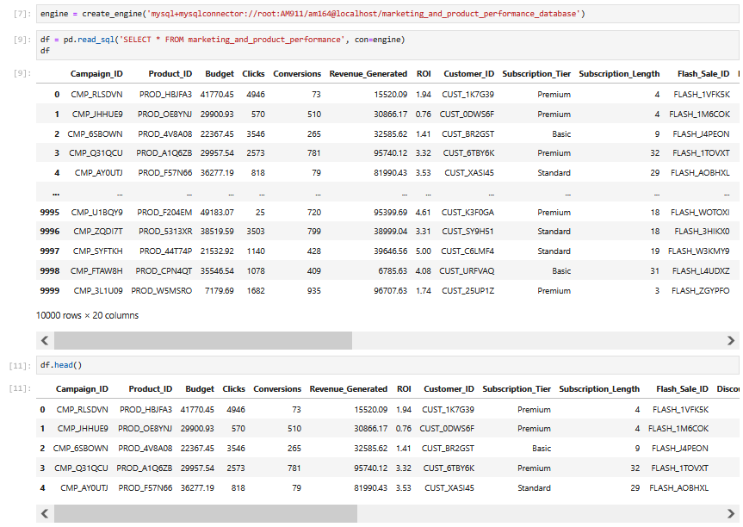
Python:
Processing :
Connected to Database
- Established link between Python and our MySQL marketing database
2. Imported Data
- Loaded all records from the "marketing_and_product_performance" table
3. Verified Data
- Checked first 5 rows to confirm successful import

Slide 26
Python:
Processing :
Connected to Database
- Established link between Python and our MySQL marketing database
2. Imported Data
- Loaded all records from the "marketing_and_product_performance" table
3. Verified Data
- Checked first 5 rows to confirm successful import

Slide 27
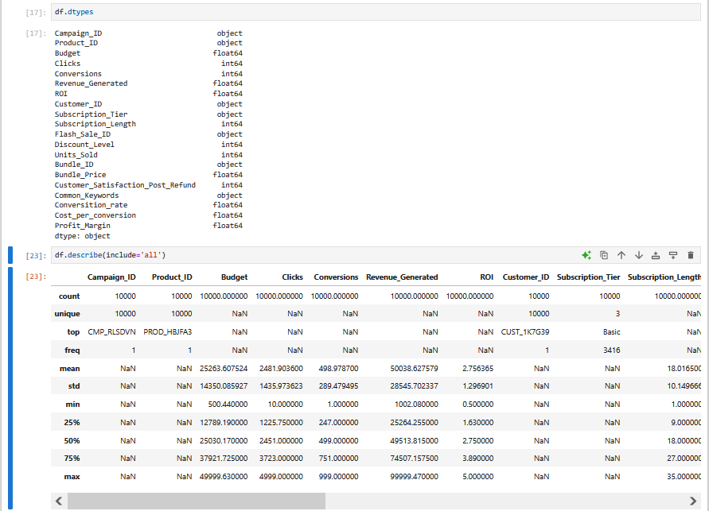
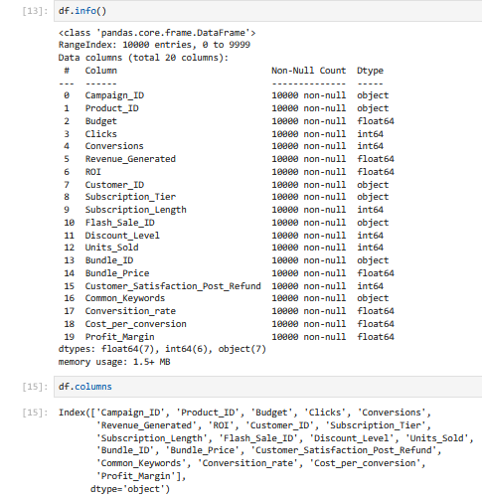
Python:
Processing :
df.info() → Shows dataset structure, columns, and non-null counts
- df.columns → Lists all available column names
df.dtypes → Displays data types for each column
- df.describe(include='all') → Provides summary statistics for all variables

Slide 28
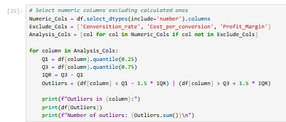
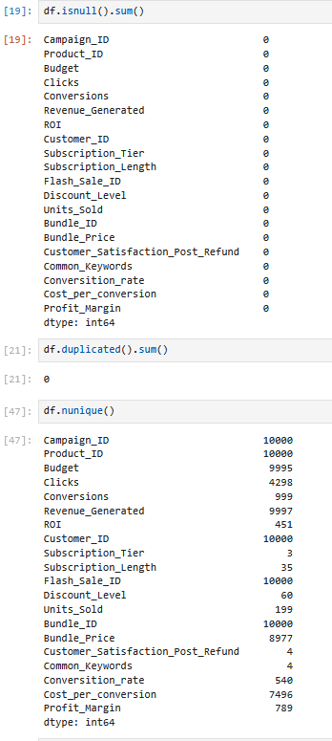
Python:
Cleaning :
df.isnull().sum(): Checks for missing values.
df.duplicated().sum(): Counts duplicate rows.
df.nunique(): Shows number of unique values per column.
IQR Method: Detects outliers using interquartile range.

Slide 29
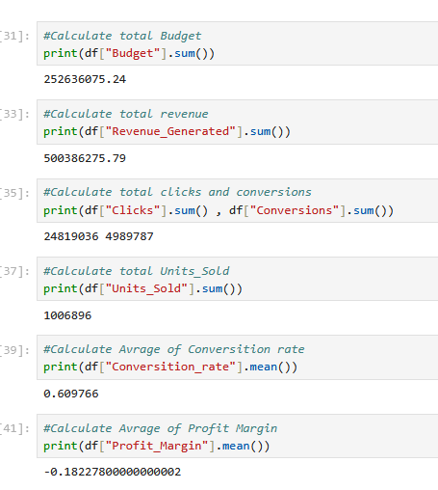
Python:
BASIC Analysis :
Total Budget – Calculated the total amount spent across all campaigns or regions
Total Revenue – Summed up the total income generated.
Total Clicks – Counted the total number of clicks from users.
Total Conversions – Calculated the total number of successful conversions.
Conversion Rate – Determined by dividing total conversions by total clicks (as a percentage).
Average Profit Margin – Calculated the average profit margin across all data points.
Average ROI (Return on Investment) – Computed the average return on investment.

Slide 30
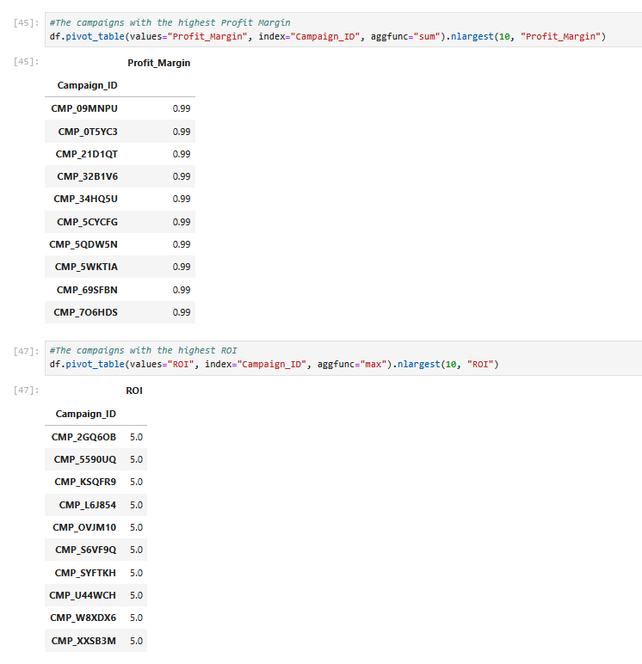
Python:
TOP PERFORMANCE :
top 10 campaigns by revenue
The campaigns with the highest Profit Margin
The campaigns with the highest ROI
The campaigns with the highest conversion rate
The top 10 products by revenue
The top 10 products by units sold
The products with the highest customer satisfaction
The top 10 customers by total spending

Slide 31
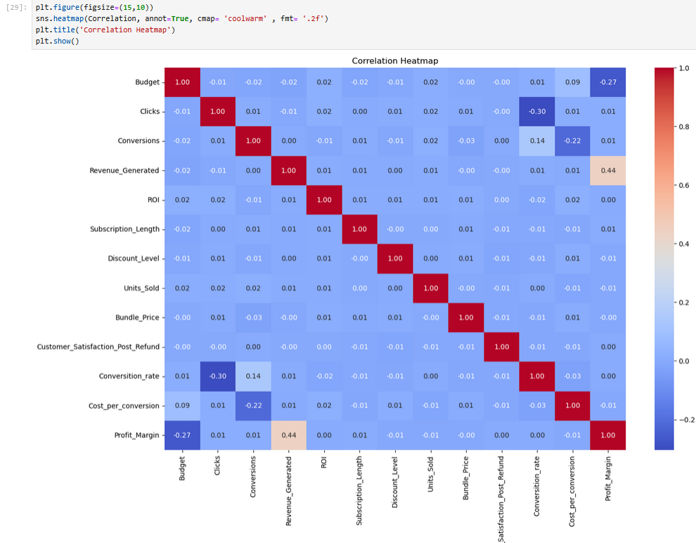
Python:
Visualization :
I calculated the correlation between numerical variables using df.corr() and saved the result in a variable called correlation.Then, I visualized it using a heatmap to easily identify the strength of relationships between variables.

Slide 32
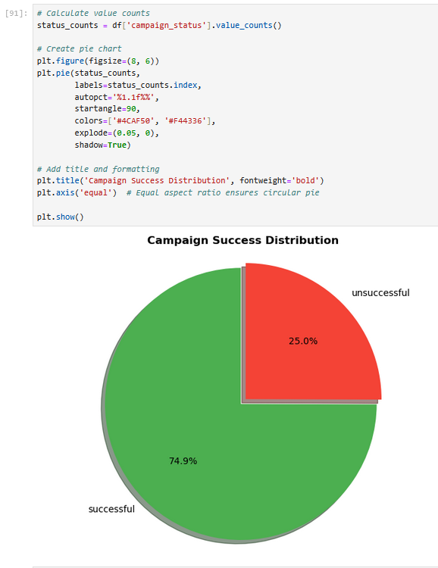
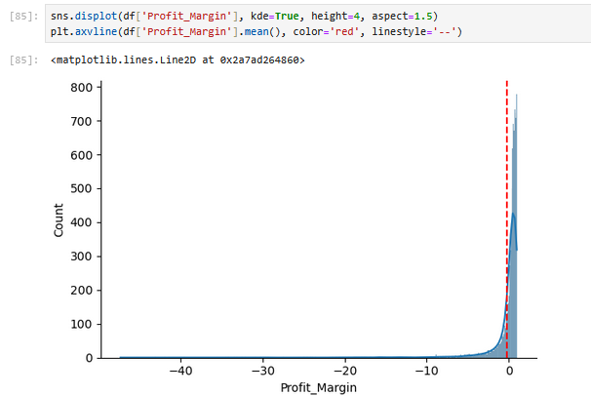
Python:
Visualization :

Slide 33
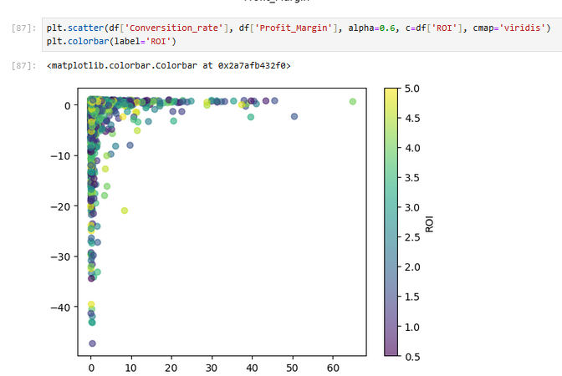
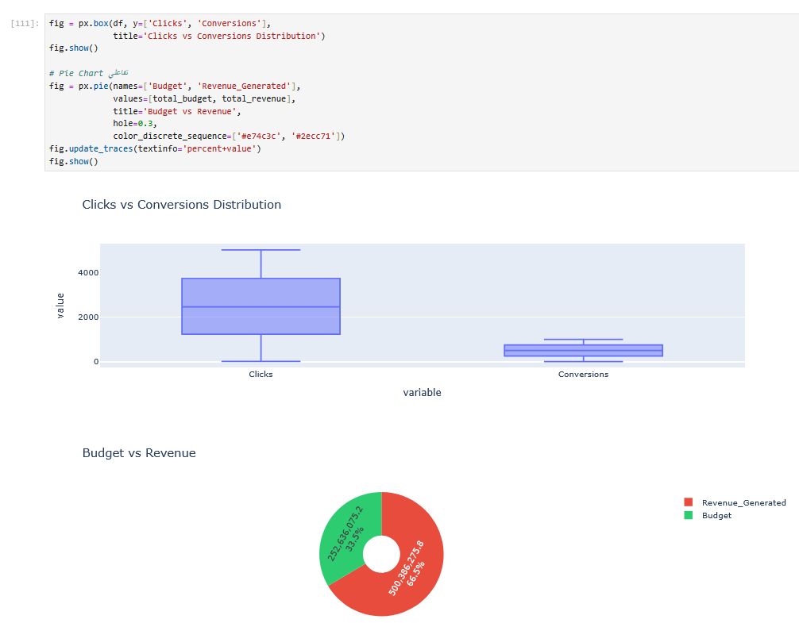
Python:
Visualization :

Slide 34
Power bi :
Components:
Home Page: This page is the first one that you see when you open Power BI and it shows the company logo and links to the dashboards.
Who are we page: A page that explains the company and what services we offer.
Dashboards: We have two main dashboards: Customer & Subscription Behavior and also Marketing & Sales Performance. Each dashboard focuses on a different part of the data.
Recommendations Page: The final page that shows insights and recommendations based on our dashboards

Slide 35
Power bi :
Features Used:
Tooltip: Three gauge graphs appear when hovering over graphs that shows comparison between our chosen category and the full data.
Drill down Graph: this allows for more detail and therefore more comprehensive understating of our data.
Buttons:
Light/ Dark mode buttons: The page colors changes when you press on it
Navigation buttons: the buttons allow you to easily navigate between pages in your dashboard
Clear filters button: allows us to easily clear all filters on the page so we can see how it originally was.

Slide 36
Power bi :
KPI & DAX:
Total Revenue = SUM(marketing_and_product_performan[Revenue_Generated])
Average ROI = AVERAGE(marketing_and_product_performan[ROI])
Average Customer Satisfaction = AVERAGE(marketing_and_product_performan[Customer_Satisfaction_Post_Refund])
Total Units Sold = SUM(marketing_and_product_performan[Units_Sold])
Total Budget = SUM(marketing_and_product_performan[Budget])
Average Conversion Rate = AVERAGE(marketing_and_product_performan[Conversion_rate])
Average Discount Level = AVERAGE(marketing_and_product_performan[Discount_Level])
Average CPC = AVERAGE(marketing_and_product_performan[Cost_per_conversion])
Number of Campaigns = COUNT(marketing_and_product_performan[Campaign_ID])

Slide 37
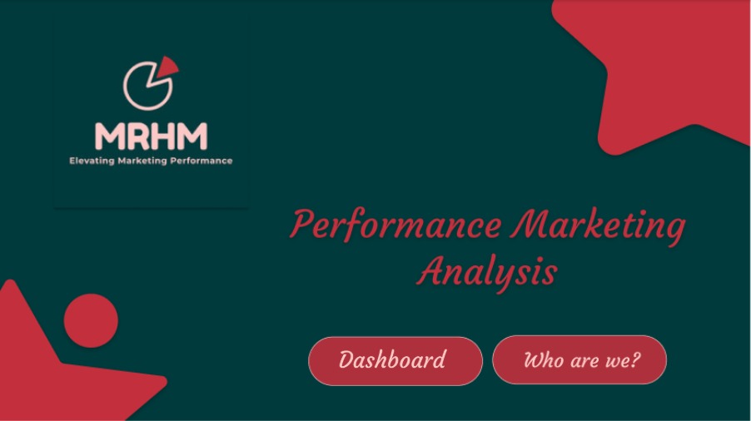
Power bi :

Slide 38

Power bi :

Slide 39
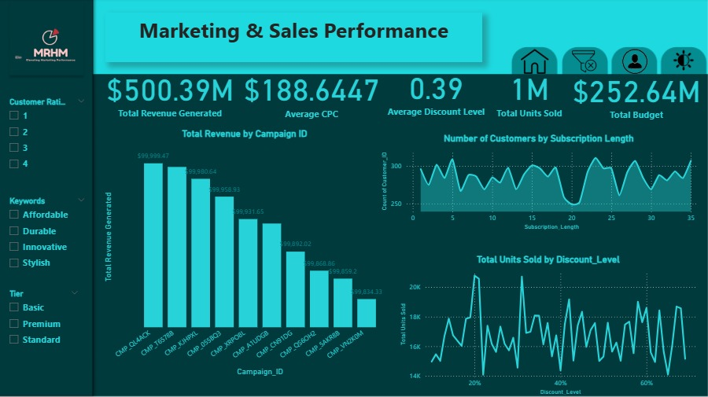
Power bi :

Slide 40
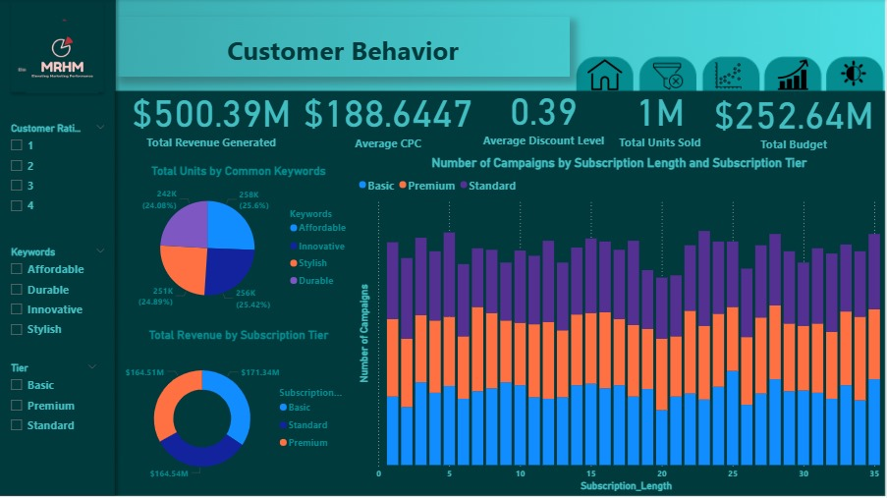
Power bi :

Slide 41

Recommendations
Recommendations
4. Tailor Offers by Subscription Tier
Why: Average subscription length is about the same (~18 months) across all tiers.
What to do: Use tier-based promotions to upsell from Basic and Standard to Premium, since all stay loyal for a similar time.
5. Use High-Converting Flash Sale Templates
Why: Some Flash_Sale_IDs consistently lead to 999 conversions, which is the maximum seen.
What to do: Replicate the structure and timing of these successful flash sales in future campaigns.
6. Improve Post-Refund Satisfaction
Why: Satisfaction is evenly spread between ratings of 1 to 4, with no one score clearly dominant.
What to do: Investigate pain points in the refund process and improve post-sale support to shift scores toward 5.
7. Double Down on Winning Keywords
Why: The most frequent keywords are:
"Affordable" (2559 times),
"Stylish" (2514),
"Innovative" (2491).
What to do: Prioritize these terms in ads and SEO; they likely align well with customer expectations and drive engagement.
1. Reallocate Budget Based on ROI
Why: ROI ranges from 0.5 to 5.0, with a median of 2.75, showing significant variation. Some campaigns yield much better returns for similar budgets.
What to do: Identify and invest more in high-ROI campaigns, and audit or scale down low-ROI ones.
2. Address Low Conversion Efficiency
Why: The average conversion rate is only 0.61, but some campaigns with very high clicks (e.g., 4946) achieve very few conversions (e.g., 73).
What to do: Audit underperforming campaigns with high clicks but low conversion rates to improve landing pages or targeting.
3. Optimize Product Bundling
Why: The correlation between Bundle_Price and Units_Sold is almost zero (-0.0025), suggesting price is not a major driver.
What to do: Focus on the value perception and relevance of the bundles rather than just price.

Slide 42
NOT DONE YET
Slide 7: Live Application + Test
Overview of the current state of the live application (beta/production)
Key testing phases (unit testing, integration testing, user testing)
Feedback from users or quality assurance
Let’s go out and see the world – you can rephrase

Slide 43
Project’s Key Deliverables
Documentation is in 2 formats:
Word document
PowerPoint presentation
Timeline for deliverables:
Data Cleaning and Preprocessing (27 February 2025)
Analysis and Insights (13 March 2025)
Forecasting Questions (27 March 2025)
Visualization and Reporting (10 April 2025)
There is also the GitHub link for the project: GitHub-Link
Python code (Jupyter Notebook)
Excel File and Dashboard
SQL Query File
Power BI Dashboard

Slide 44
Project Team + Roles
Team Leader: Malak Waheed
Team Members:
Analysis: Malak Waheed
Preprocessing: Hager Mostafa
Visualization: Rahma Mahmoud
Forecasting: Mariam Ahmed

Slide 45
Conclusion:
This project uncovered key insights into subscription performance through clean data preprocessing and metrics
All in all, this was a fun and insightful dive into the data. We dug up clear results and practical ideas to focus on what really works, like the top keywords, offers, and campaigns. The data was clean and ready, making it easy to spot the key stats. Let’s roll with these insights and level things up!

Slide 46
ANY QUESTIONS ?

Slide 47

THANK YOU
We appreciate your time and attention.
If there are any questions or feedback, feel free to ask us now!
Or you can contact us later through this email: marsa55marsa@gmail.com

